Slide 1

P112 – Group-2 19-04-2022
Neha Ramchandani
Group-2 : Members-
Mr. Dion Philip ,
Miss. Shital Gunjal ,
Miss. Mayuri Satish Gosavi ,
Miss. Salla.H.Divya ,
Mr. Akshay G Hegde,
Mr. Abhishek. P

Slide 2
BUSINESS PROBLEM
An International E-Commerce company (Electronic goods) wants to analyse their customers with respect to their services and some important customer success matrix.
Consider that your team has been assigned the task of evaluating the data collected about the customers in the past & based on that make predictions for the shipments reaching in the future.

Slide 3
Objective
The objective is to predict if the shipments will reach on time or not.

Slide 4
Project Milestones
Collection of dataset
Business understanding
Initial analysis(EDA), Feature engineering
Model Deployment
Model Building

Slide 5

DATA SETS

Slide 6
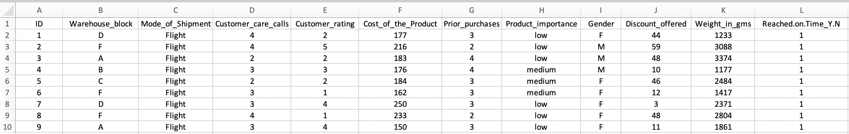
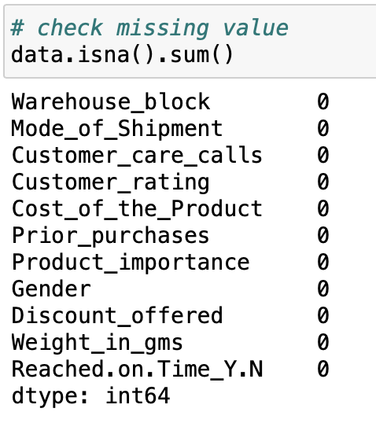
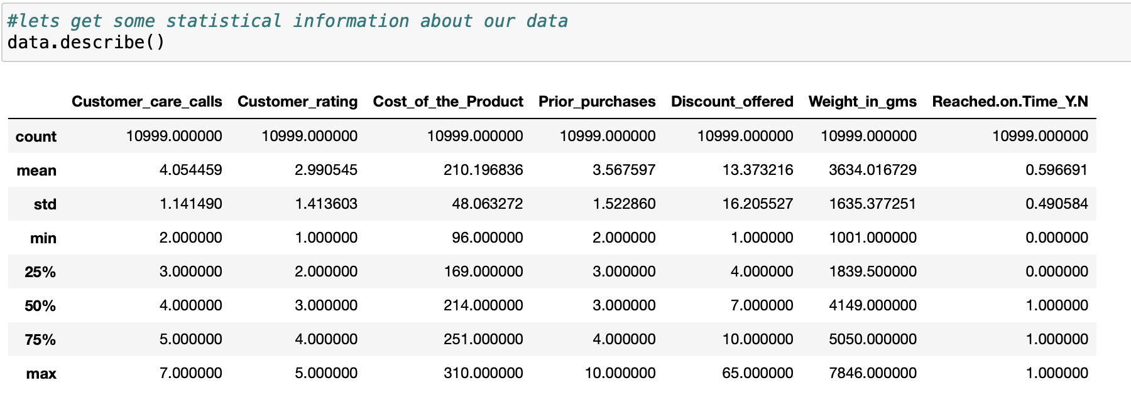
DATA SETS
Data set includes 10999 rows and 12 columns
There are no missing values
Descriptive statistics of the dataset

Slide 7
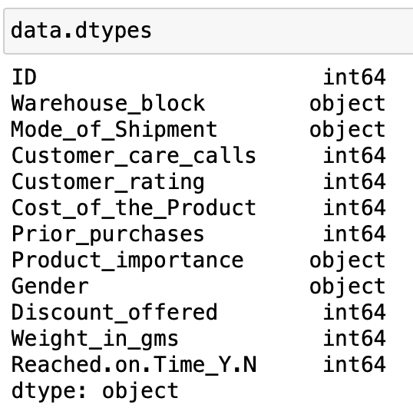
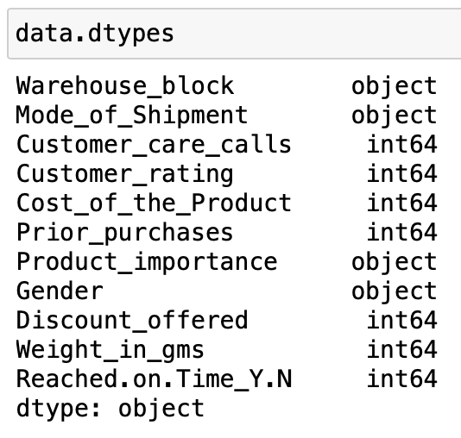
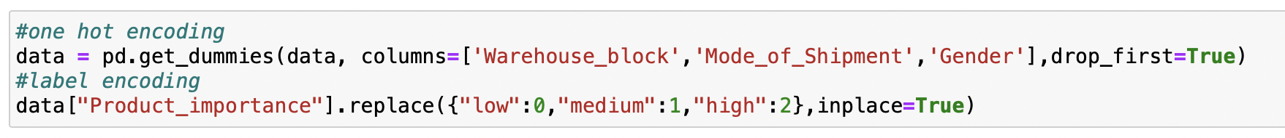
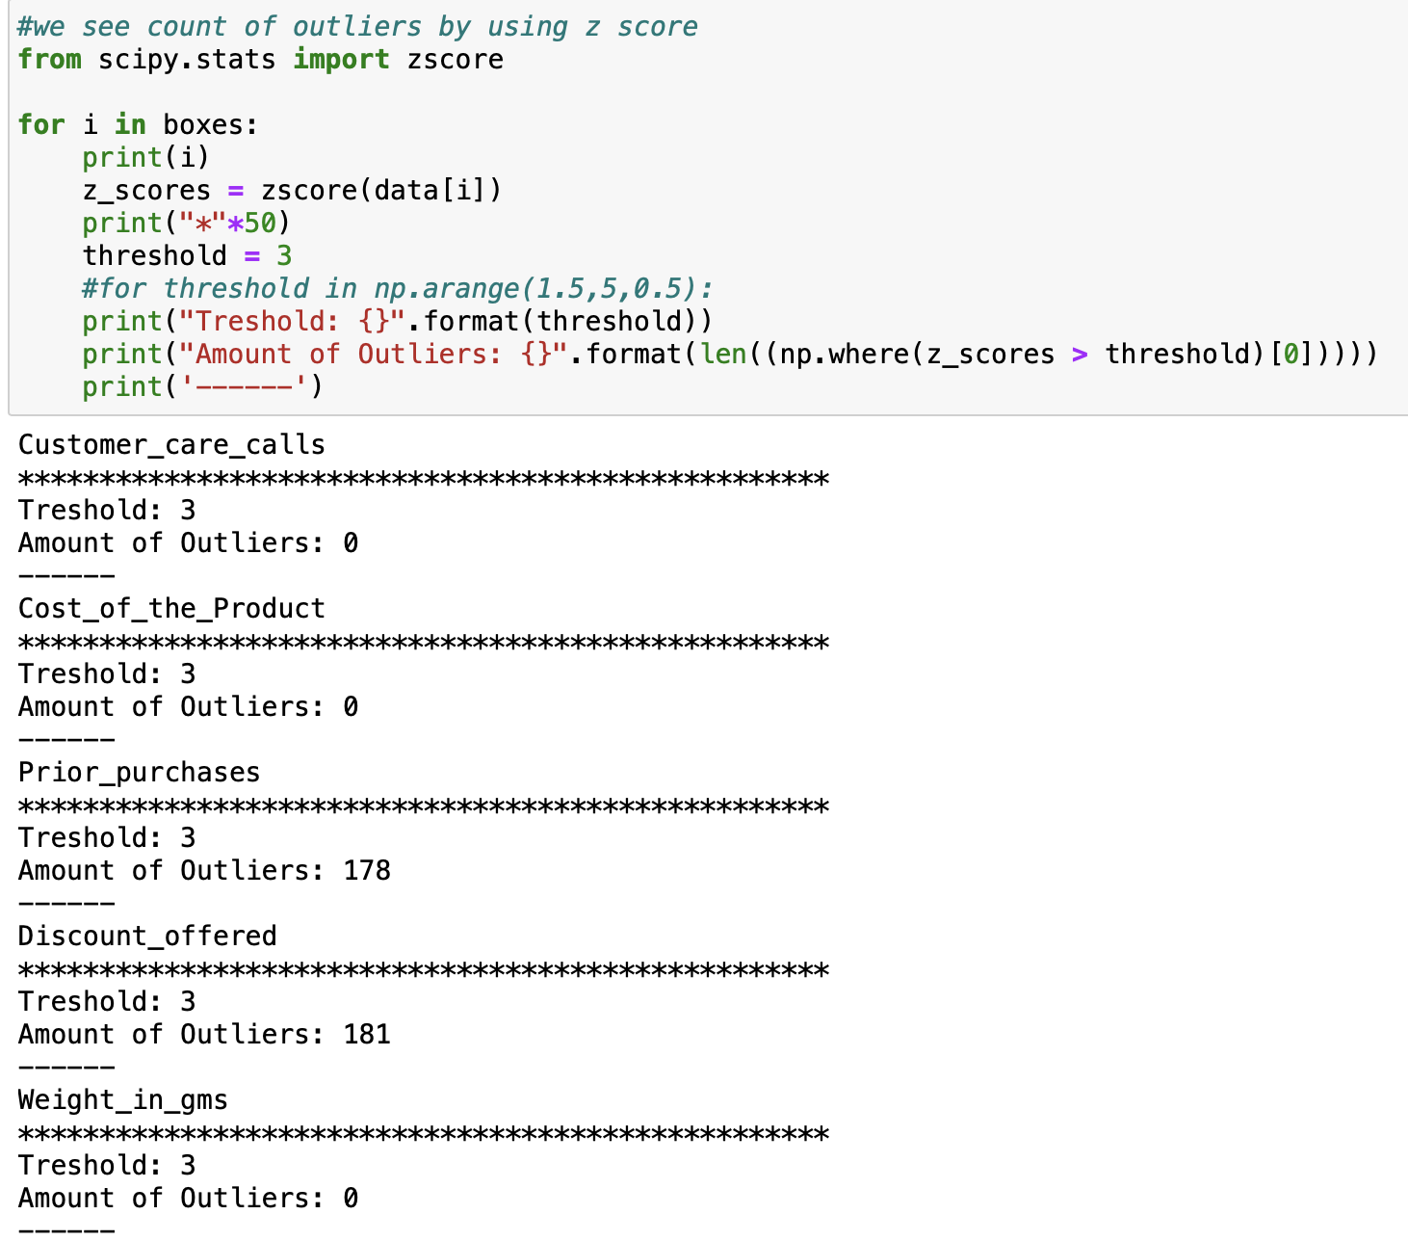
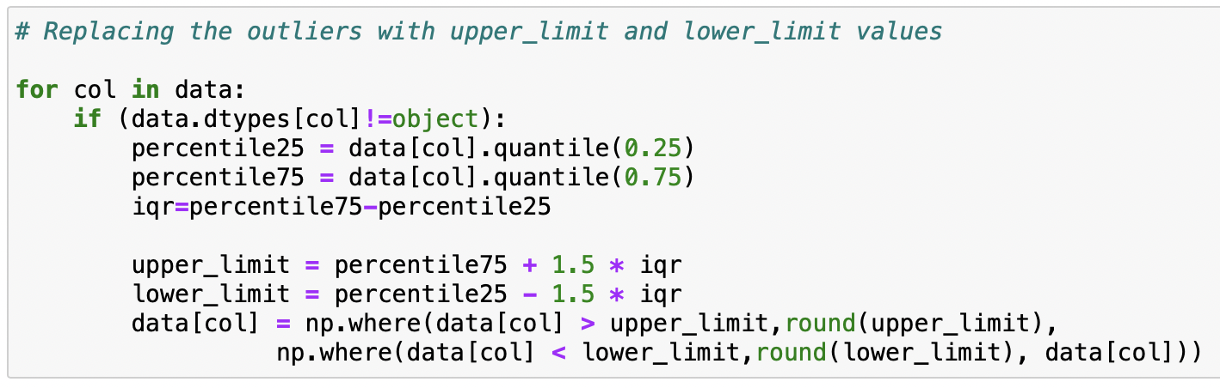

Datatypes of the dataset
Categorical variables are converted using one hot encoding
Before and after using hot , label encoding
Outliers are detected in 2 columns
Replacing outliers with upper and lower limit

Slide 8
EDA & FEATURE ENGINEERING
Checked for the outliers and replaced them with upper_limit and lower_limit values.
Categorical variables from the columns Warehouse_block , Mode_of_shipment and Gender have been converted to Warehouse_block_B, Warehouse_block_C, Warehouse_block_D, and Warehouse_block_F, Mode_of _Shipment_Road, Mode_of _Shipment_Ship and Gender_M respectively using one hot encoding.
Labels from the column Product_importance have been converted to numerical.
Unnecessary Column ID has been dropped.

Slide 9
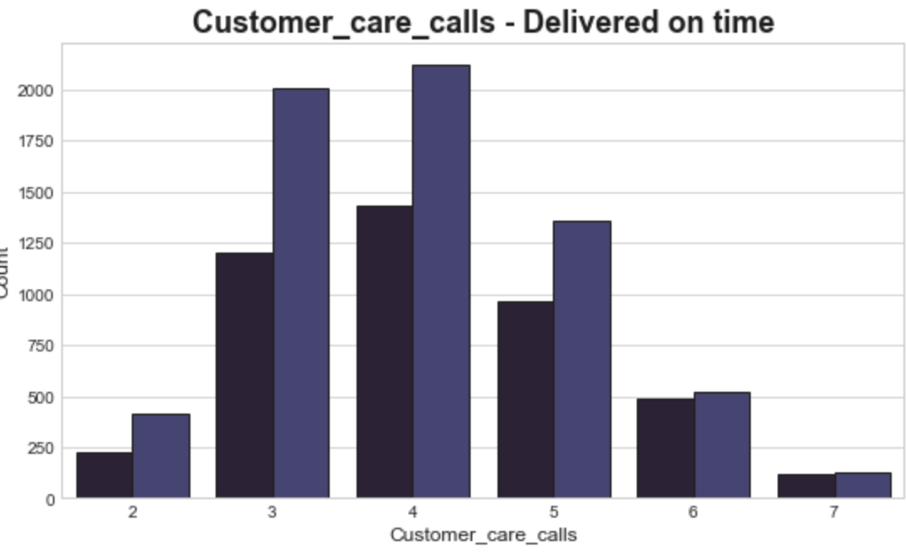
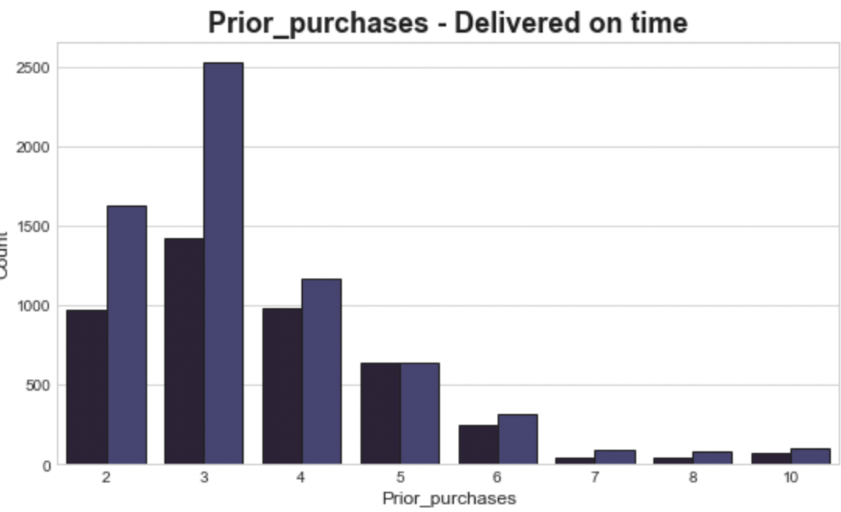
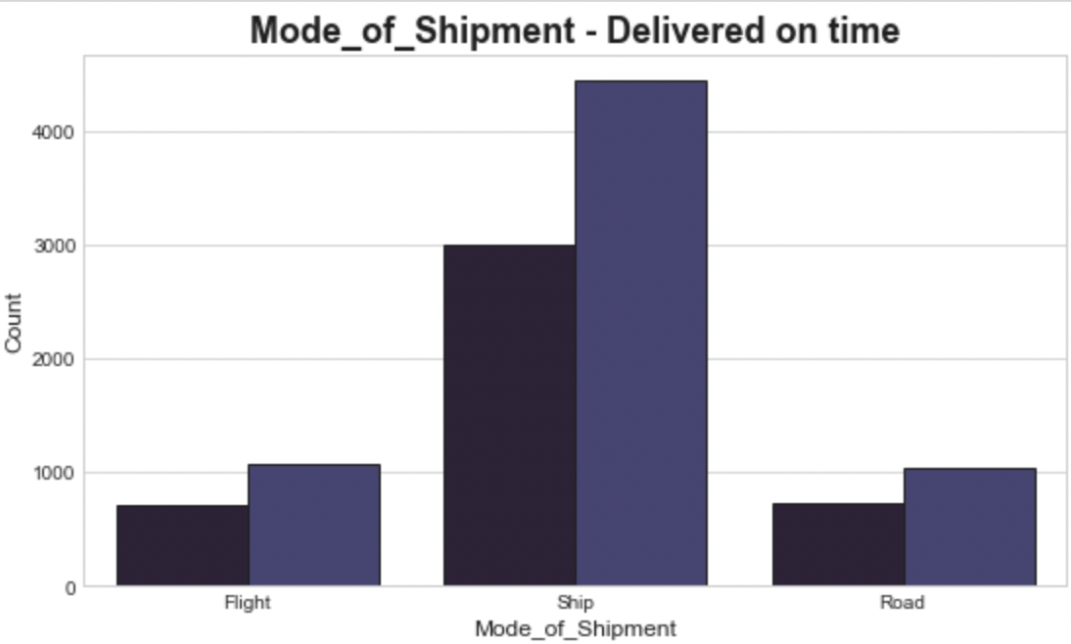
EDA VISUALIZATION
In the above plot, delivery of the shipments is more to customers with more no.of customer calls i.e; 3-5 calls
Here, customer with 3-6 prior purchases has more shipment delivered
Ship is frequently used mode of the shipment

Slide 10
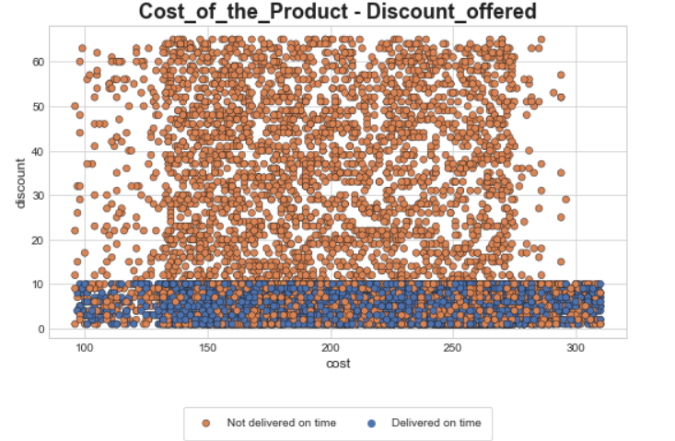
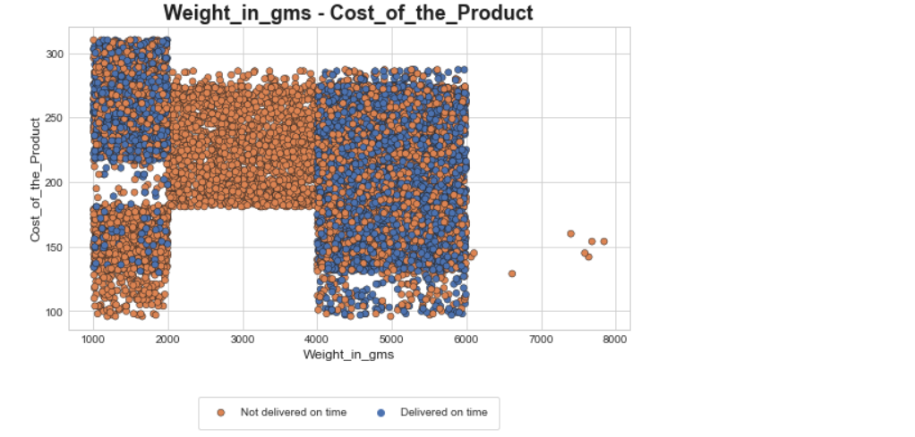
From the given graph, we can see
Customers who received a discount of more than 10 dollars did not receive on time delivery. This feature will play important role in prediction.
2000 to 4000 and above 6000 gram products are not delivered on time every time.
Delivered on time products' weights changing between 1000 to 2000 and 4000 to 6000 grams

Slide 11
MODEL BUILDING

Slide 12

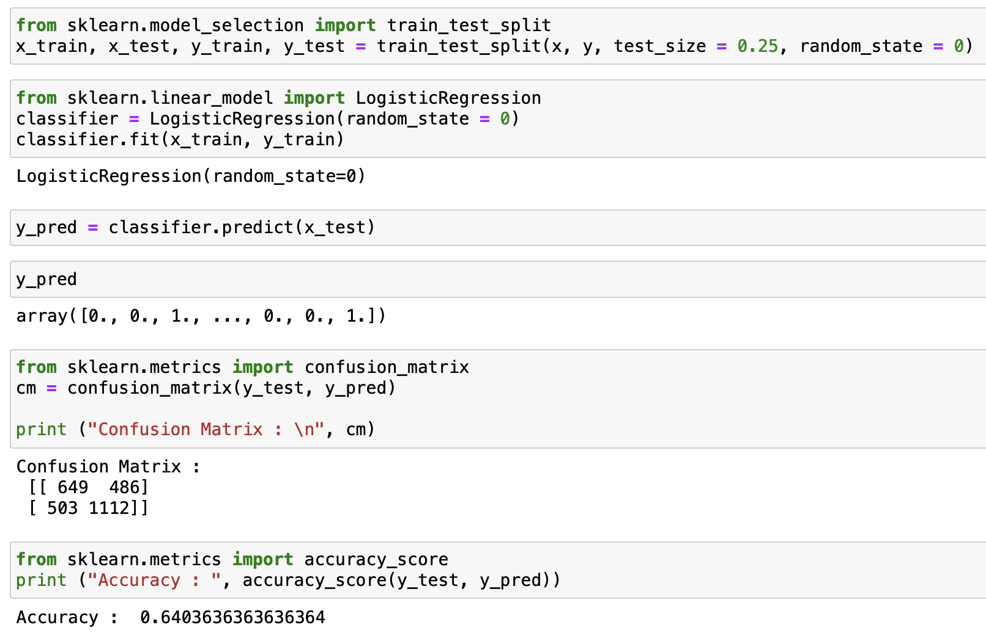
Model building
Accuracy | 64%
Dataset shape | 10999*14
Data split | Train – 75% Test – 25%

Slide 13

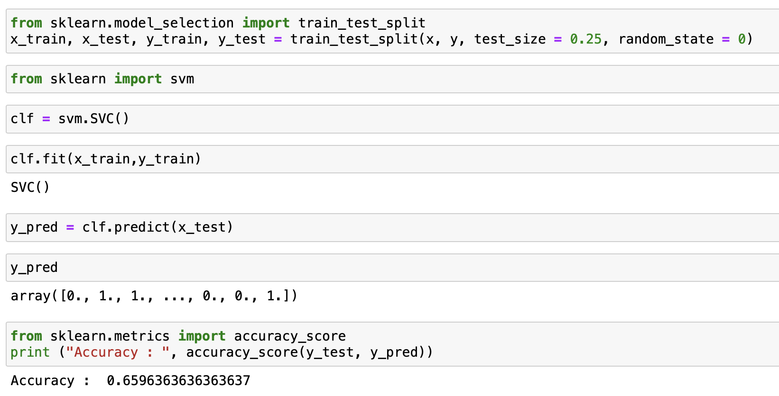
Accuracy | 65.96%
Dataset shape | 10999*14
Data split | Train – 75% Test – 25%

Slide 14

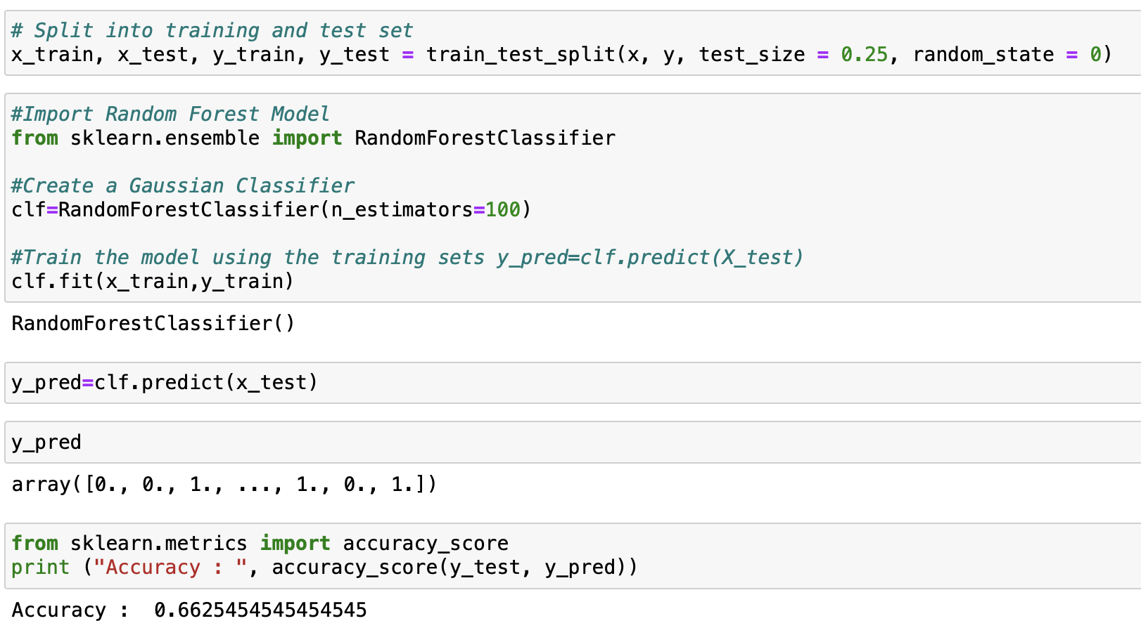
Accuracy | 66.25%
Dataset shape | 10999*14
Data split | Train – 75% Test – 25%

Slide 15

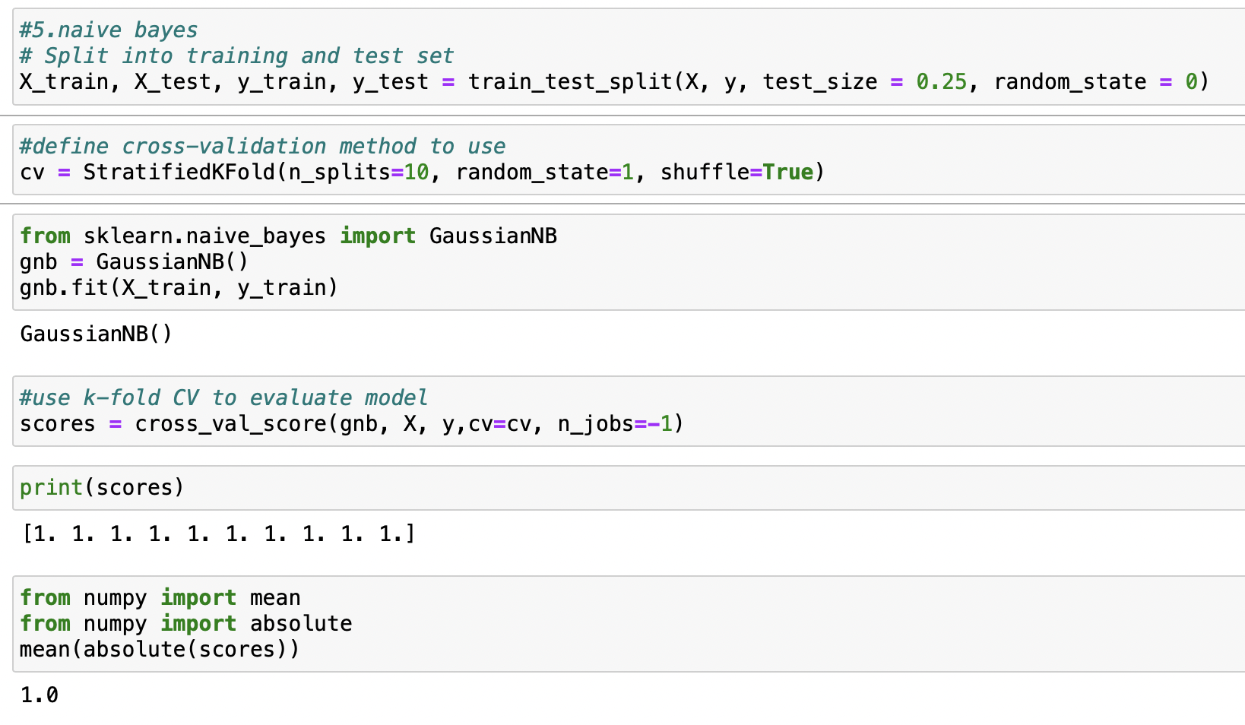
Accuracy | 100%
Dataset shape | 10999*14
Data split | Train – 75% Test – 25%

Slide 16

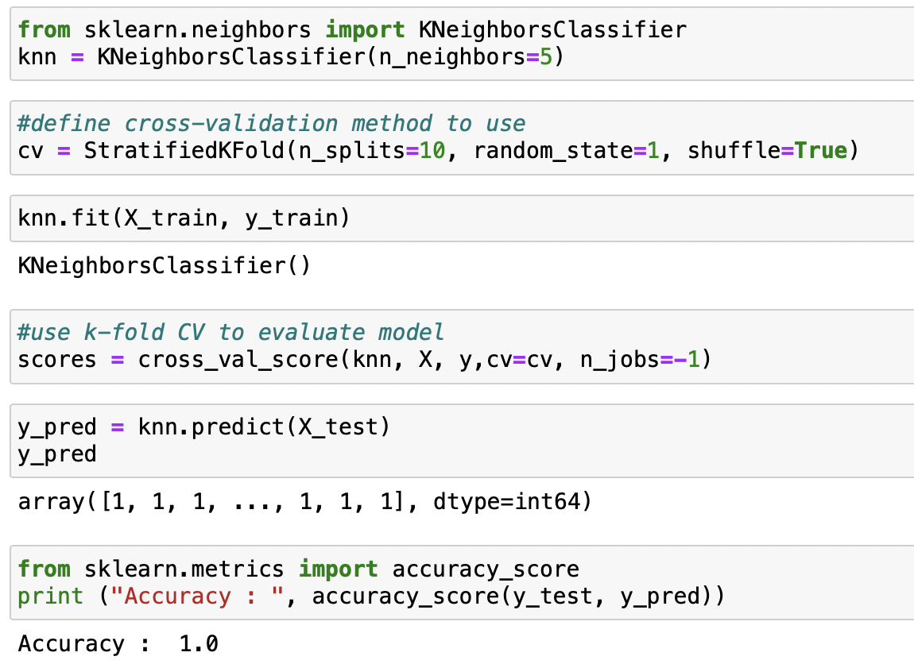
Accuracy | 100%
Dataset shape | 10999*14
Data split | Train – 70% Test – 30%

Slide 17

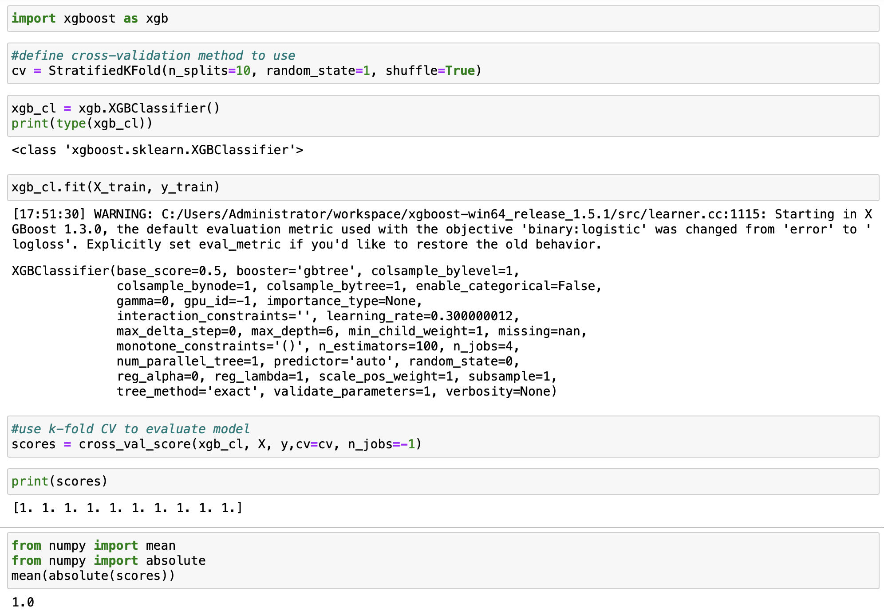
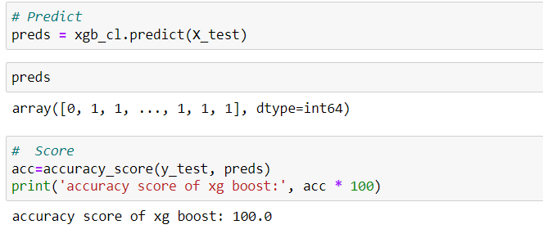
Accuracy | 100%
Dataset shape | 10999*14
Data split | Train – 75% Test – 25%

Slide 18
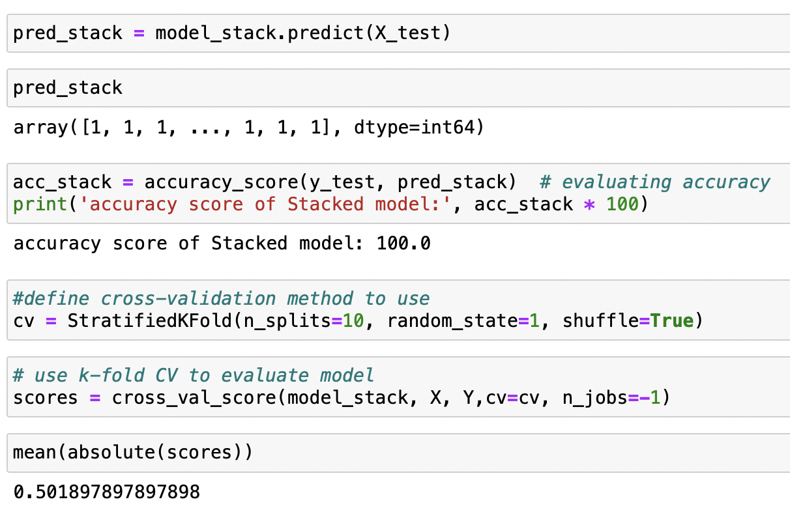
7. Stacking
Accuracy | 100%
Dataset shape | 10999*14
Data split | Train – 75% Test – 25%

Slide 19
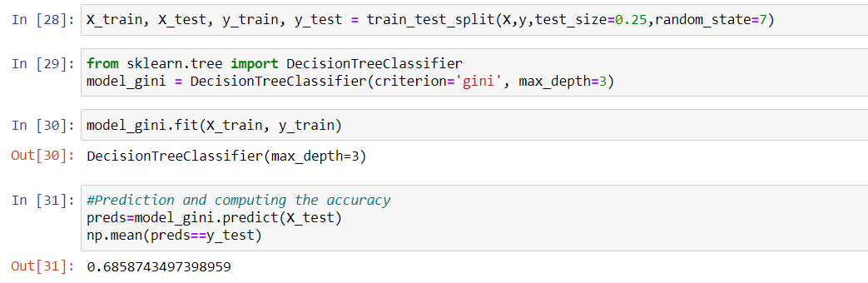
8. Decision Tree
Accuracy | 68.58%
Dataset shape | 10999*14
Data split | Train – 75% Test – 25%

Slide 20
Models comparison
ML Model | Accuracy
Logistic Regression | 64%
Support Vector Machine | 65.96%
Random Forest | 66.25%
XGBoost | 100%
KNN | 100%
Decision Tree | 68.58%
Naïve bayes | 100%
Stacking | 100%

Slide 21
MODEL DEPLOYMENT
After the Model building and Evaluation process, we have deployed the code using “Streamlit”.
• We have selected the best model and used in our deployment
phase.

Slide 22
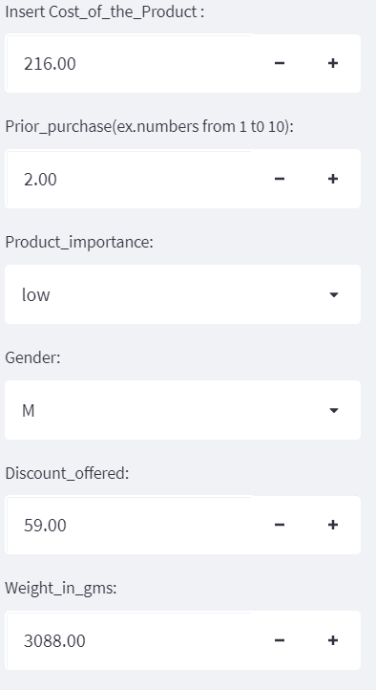
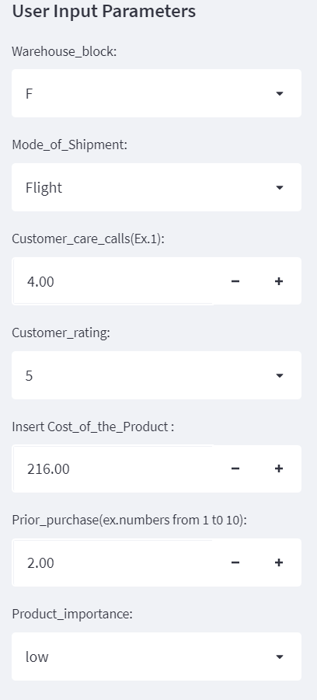
Model deployment using streamlit

Slide 23
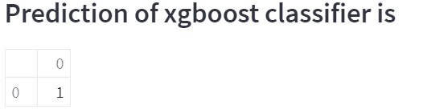
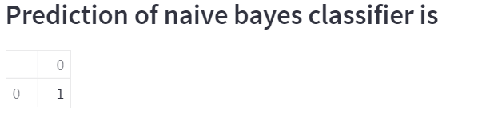
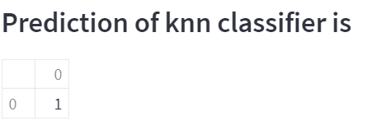
Model predictions
XgBoost classifier:-
Naïve Bayes classifier:-
K nearest neighbor classifier :-

Slide 24
CHALLENGES FACED
In the dataset there is no missing values also data types are shown are correctly so we confused little bit while doing the EDA.
While deploying the model with best accuracy , there was challenging related to the categorical and numerical features .

Slide 25
How did we overcome
We converted categorical features to numerical features and to take the unique values of particular columns in the dataset

Slide 26


